Slide 1
Essex Gliding Club
Simulator Presentation
Saturday 14th march 2020
Topics for Discussion:
The ‘Condor’ Program – normal use
The alternative ‘Prepar3d’ by Lockheed Martin
The Simulator – physical design restrictions - why it is the way it is
The Touch Screen Interface for the Condor program
It’s a ‘Work In Progress’!
Changes happening soon
What could be done
What do you want?

Slide 2
Essex Gliding Club
Use of the ‘Normal’ Condor interface:
Mouse and Keyboard essential
Lots of steps required to set up a flight and user profile
Not suited for use in a cockpit
Condor based on competition and game playing
Extensive changes required for instructional use

Slide 3
Essex Gliding Club
Lockheed Martin ‘Prepar3d’ Software
Customers around the world rely on Prepar3D for immersive, experiential learning. It offers users a platform to:
Experience combat scenarios involving a complement of weapons and sensors
Program artificially intelligent (AI) behaviors in scenarios
Utilize the Multichannel capability to increase performance on multi-screen and dome setups by running concurrently on multiple systems
Connect to a Distributed Interactive Simulation (DIS) network session and integrate with other simulators
Support for the most popular Common Image Generator Interface (CIGI) packets
Control multiplayer scenarios and modify role-players in real-time using SimOperator
Experience a mission before it happens to increase effectiveness and reduce response time
Learn and test their knowledge in the same environment in which they will operate
Re-create scenarios with operational data and experiment with different variables
Train for scenarios in aviation, air traffic control, ground vehicle operation and disaster response
The license is available to those that are training, instructing, simulating, or learning.
Prepar3D is not to be used, offered, sold or distributed through markets or channels for use as a personal/consumer entertainment product.
Not Really Designed For Glider Pilot Instruction!!

Slide 4
Essex Gliding Club
Simulator Construction
Limited space – 12 ft x 12 ft for 5 screens
Not enough room for a ‘real’ two seater fuselage
No existing design on which to base ours – would make lots of changes for a second iteration!
Projector positioning – short throw projectors
Computer power – video card limitations
Three computers being used:-
Main Display
Interface for controls
Cockpit Displays
Lots of software has been written!

Slide 5
Essex Gliding Club
Software to Control Condor
This is the software written to give a more intuitive interface for the control of Condor
Use of the ‘Touch Screen’ to select scenarios and various parameters
Gives us total flexibility in deciding what we want to do with the simulator
Additional features can be added – the only limitation is what is available within the Condor program
BUT
Testing the software!!
Testing software is a very, very, very time-consuming task, and should NEVER be done by the person writing the software. It really needs several people who are intent on breaking it!

Slide 6
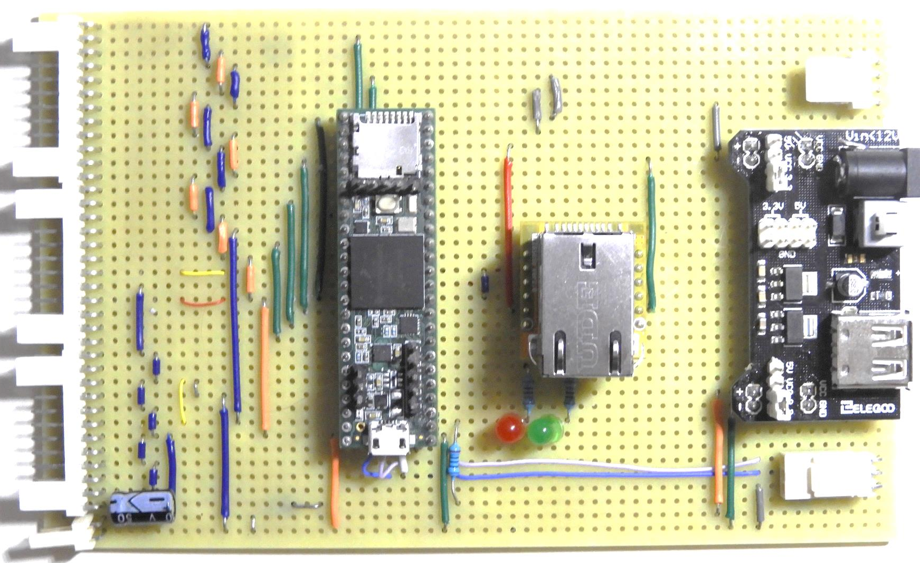
Essex Gliding Club
Microprocessor Interface For Controls

Slide 7
Essex Gliding Club
And More Software….
Software has to be written for the control interface microprocessor…. And tested!!

Slide 8
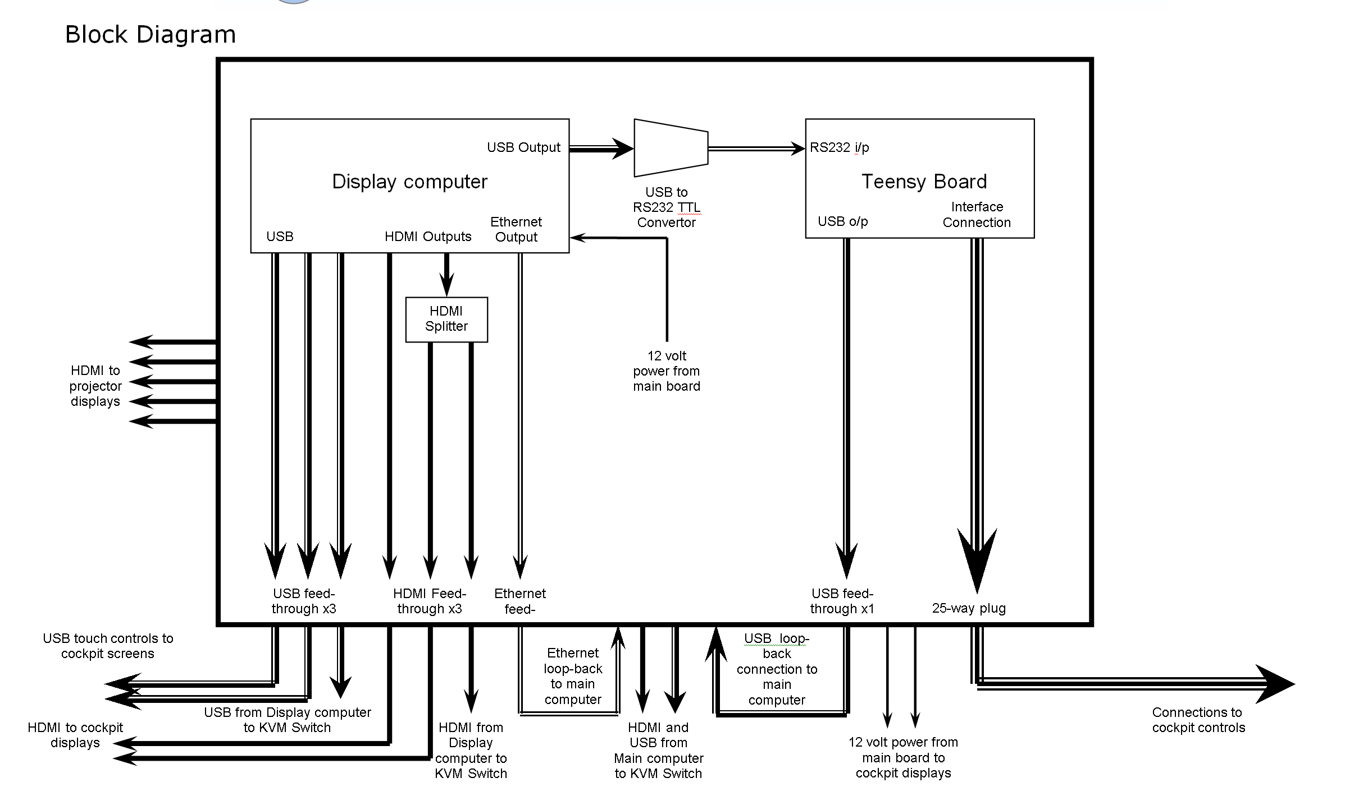
Essex Gliding Club

Slide 9
Essex Gliding Club

Slide 10
Essex Gliding Club

Slide 11
Essex Gliding Club

Slide 12
Essex Gliding Club

Slide 13
Essex Gliding Club

Slide 14
Essex Gliding Club

Slide 15
Essex Gliding Club

Slide 16
Essex Gliding Club

Slide 17
Essex Gliding Club

Slide 18
Essex Gliding Club

Slide 19
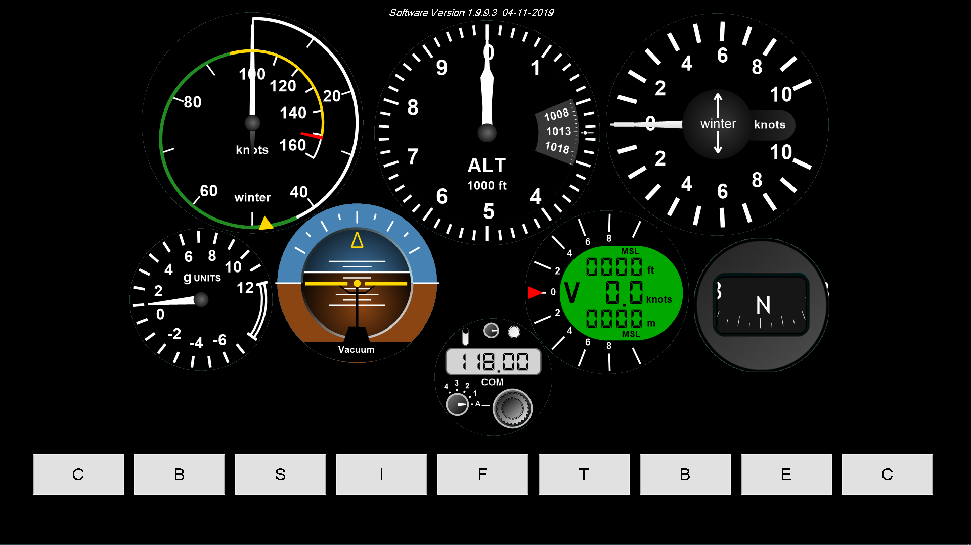
Essex Gliding Club

Slide 20
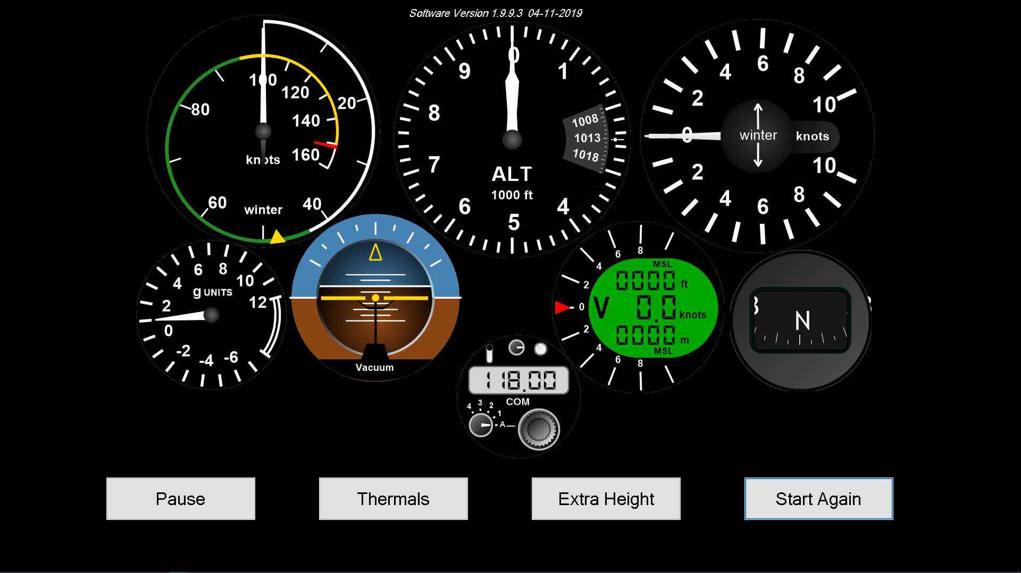
Essex Gliding Club

Slide 21
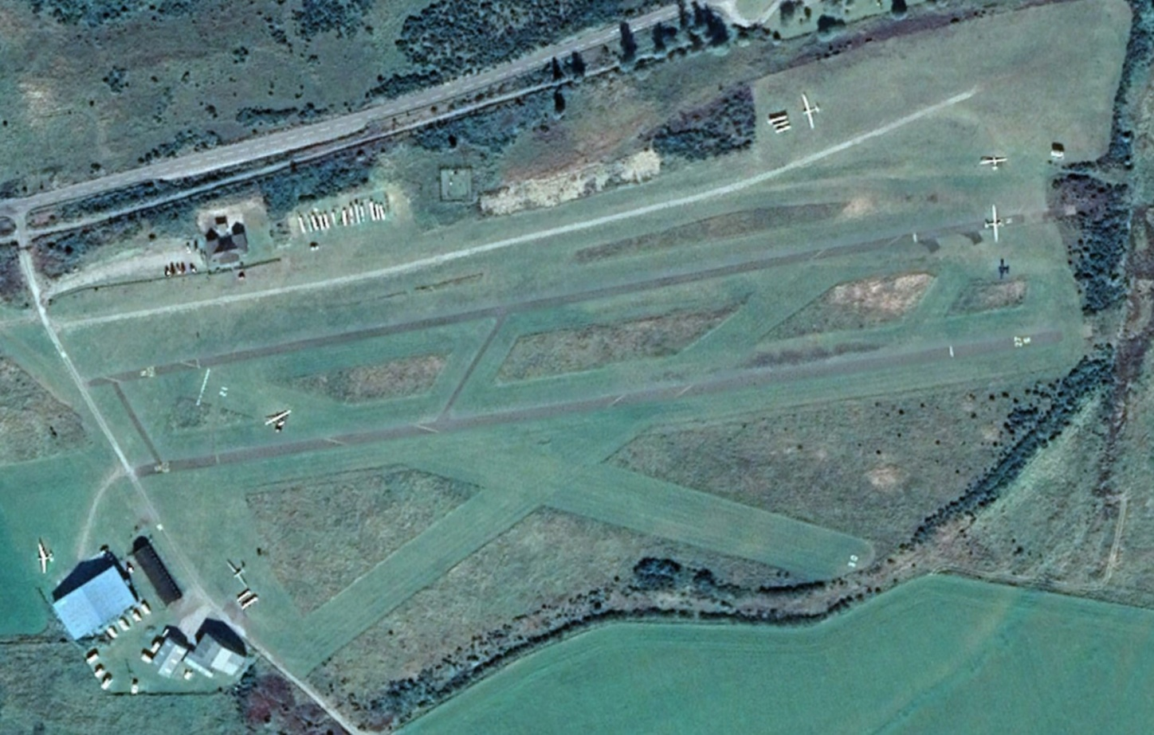
Essex Gliding Club
Future Improvements / Changes
Selection Of Site, Wind Direction And Speed
Wind
Speed
Wind Direction

Slide 22
Essex Gliding Club
Future Improvements / Changes
Selection Of Site, Wind Direction And Speed
Change cloud parameters
Change thermal parameters
Replay of student’s flight
Over to you – what do YOU want?

