Slide 1
Simulator Design and Construction
Essex Gliding Club
Objectives:
5 screens
No keyboard or mouse
Intuitive use
As realistic as possible for glider flying
Two-seater required for training

Slide 2
Limitations:
Essex Gliding Club
Space
No two-seater fuselage available
Condor regarded as the best simulation
Only 1 video card supported by Condor
Money!!

Slide 3
Basic design:
Essex Gliding Club
Used half of the old clubhouse, giving a 12ft x 12ft space
Ceiling height and space dictated a 4:3 aspect ratio for the screens
Cockpit ‘Touch Screens’ used to eliminate the need for keyboard and mouse
Pre-programmed scenarios help to make it user-proof
Fuselage had to be ‘home built’
Video card to have independent monitor capability

Slide 4
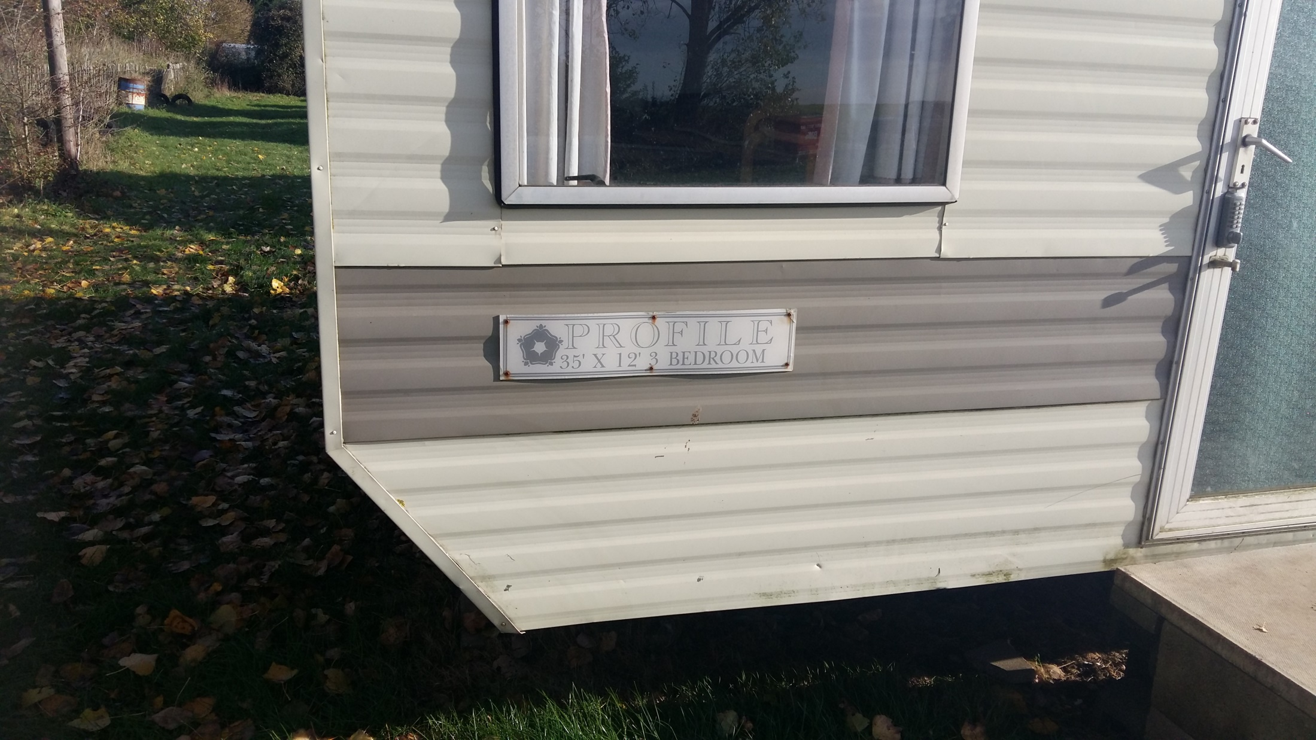
Essex Gliding Club

Slide 5
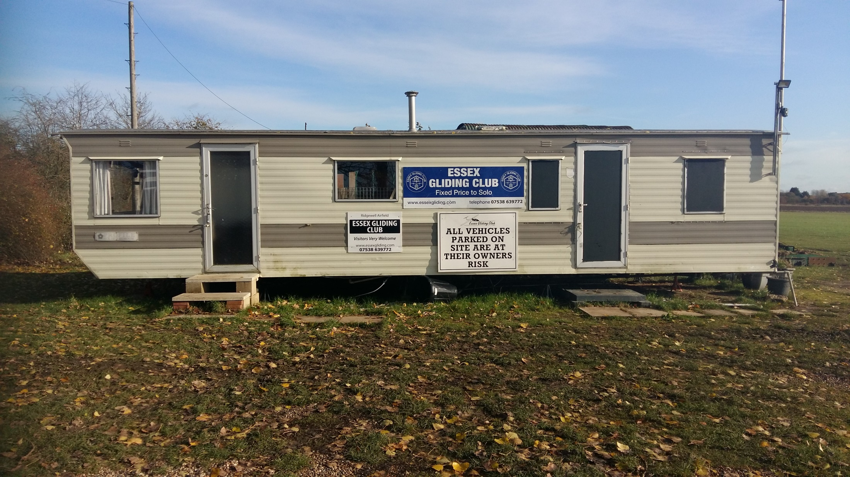
Essex Gliding Club

Slide 6
Essex Gliding Club
Layout of Simulator, Screens and Projectors
Ceiling MountedProjector
Floor MountedProjector
Floor MountedProjector
Rest of mobile home to be used as training and resource centre
Ceiling MountedProjector
Ceiling MountedProjector
Fuselage
Hinge

Slide 7
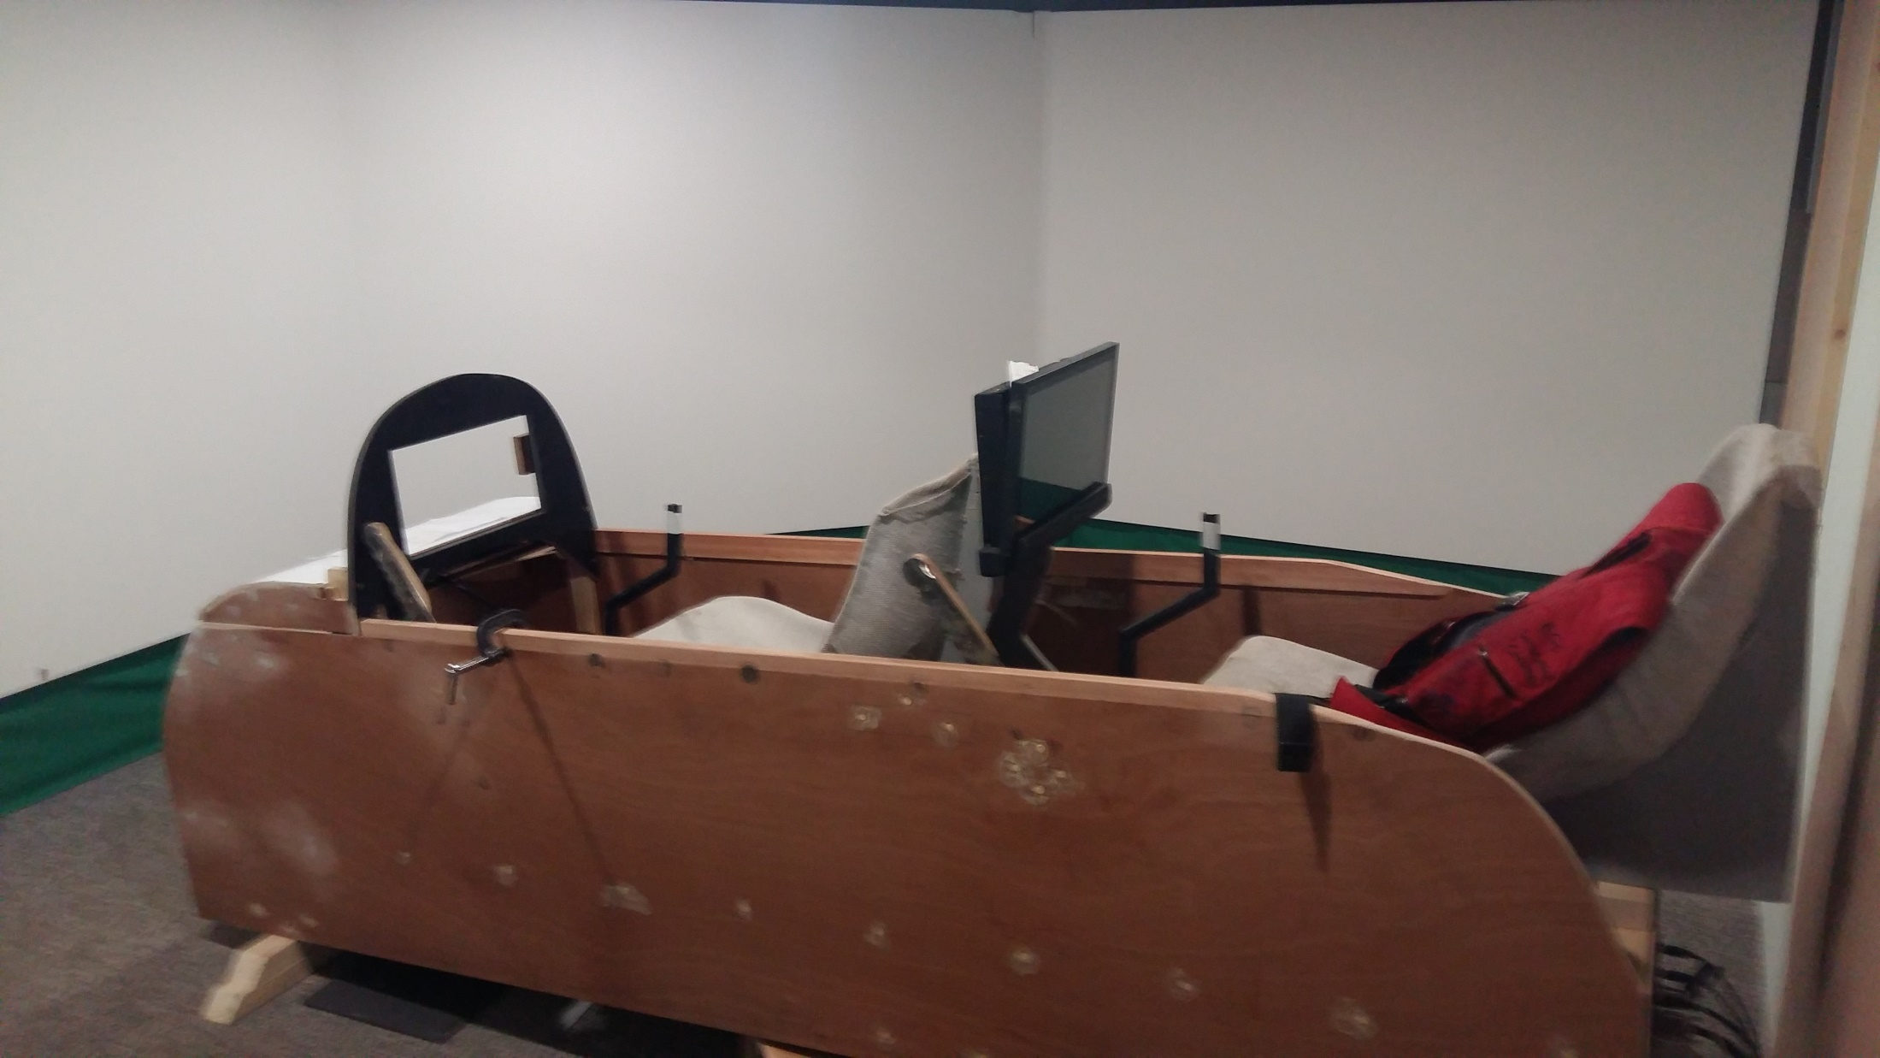
Essex Gliding Club

Slide 8
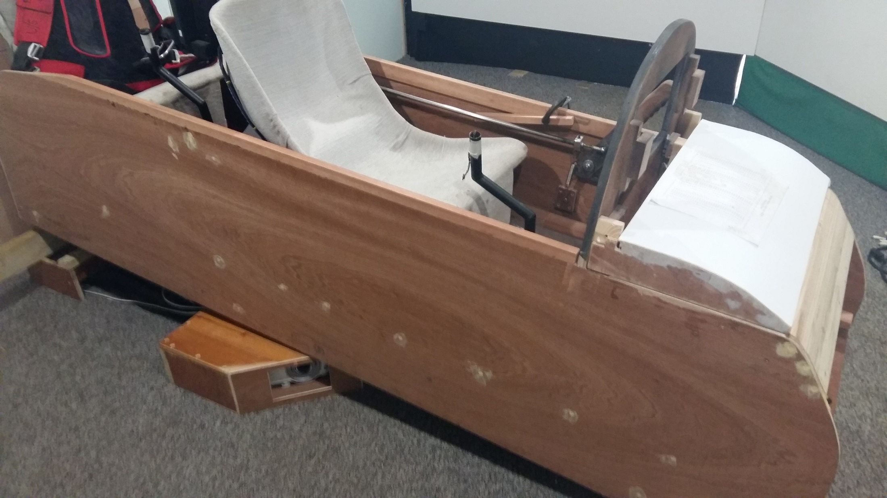
Essex Gliding Club

Slide 9
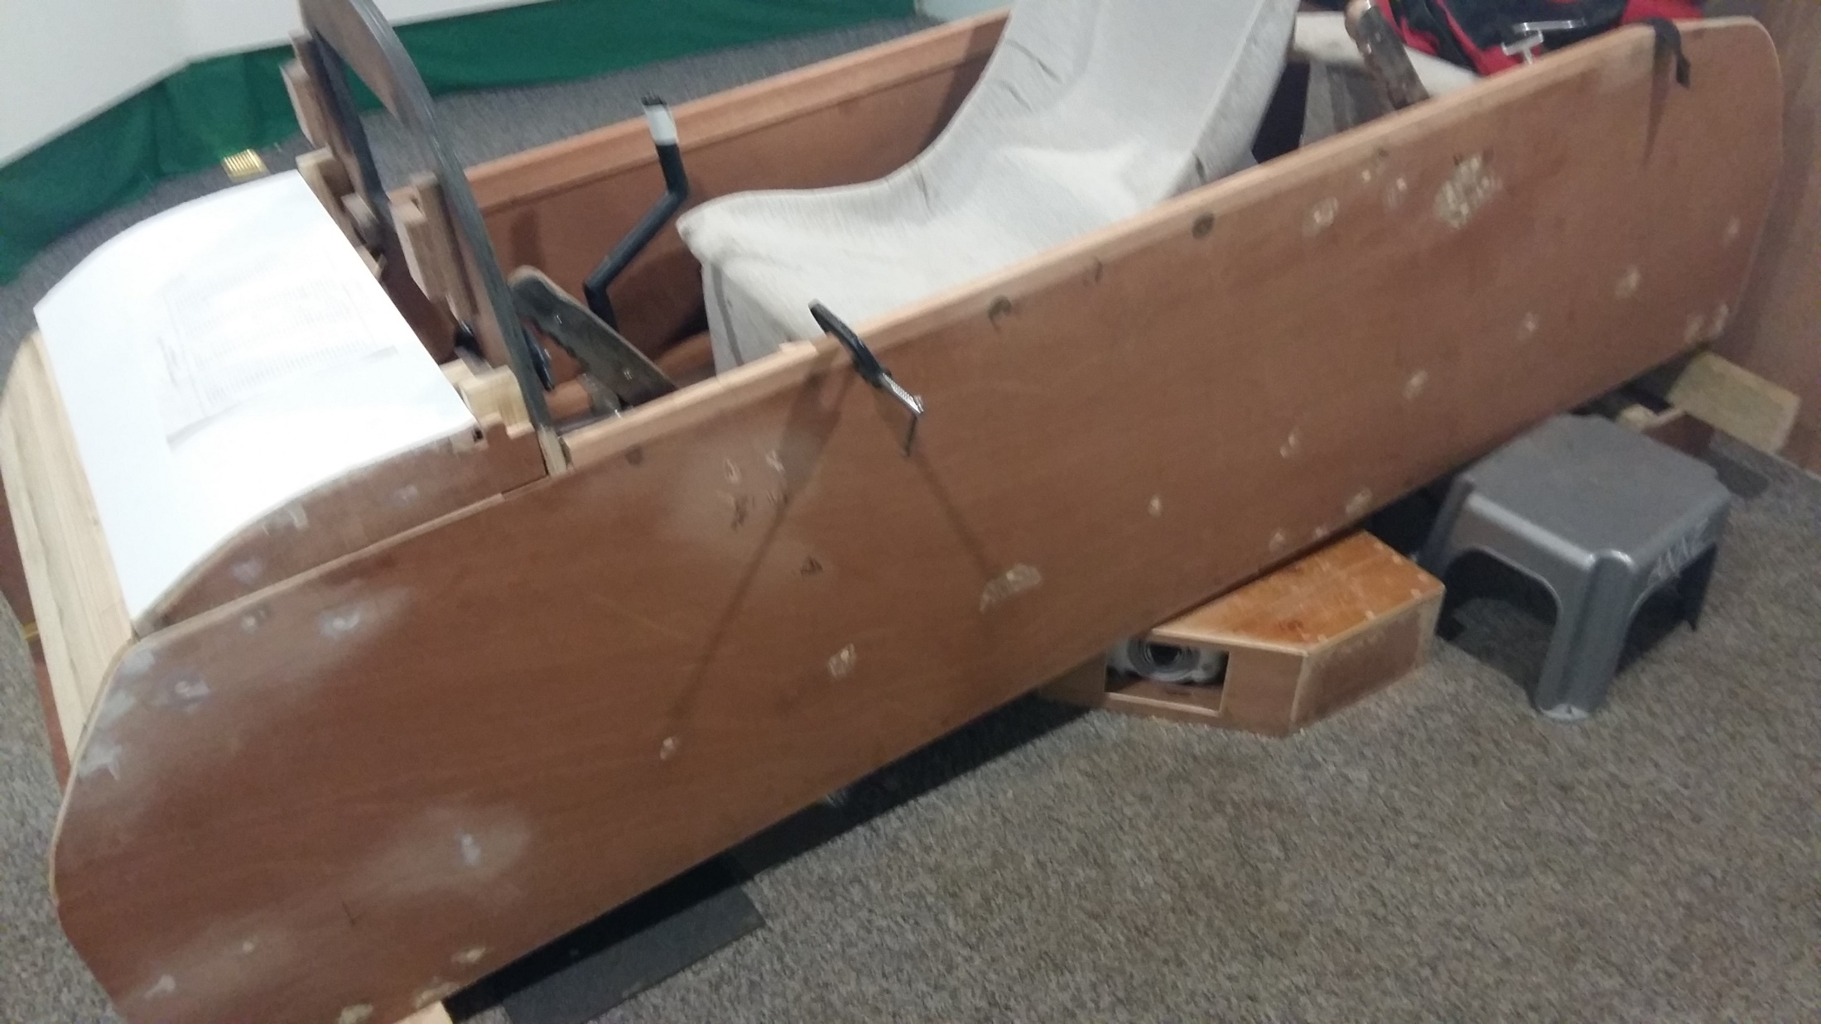
Essex Gliding Club

Slide 10
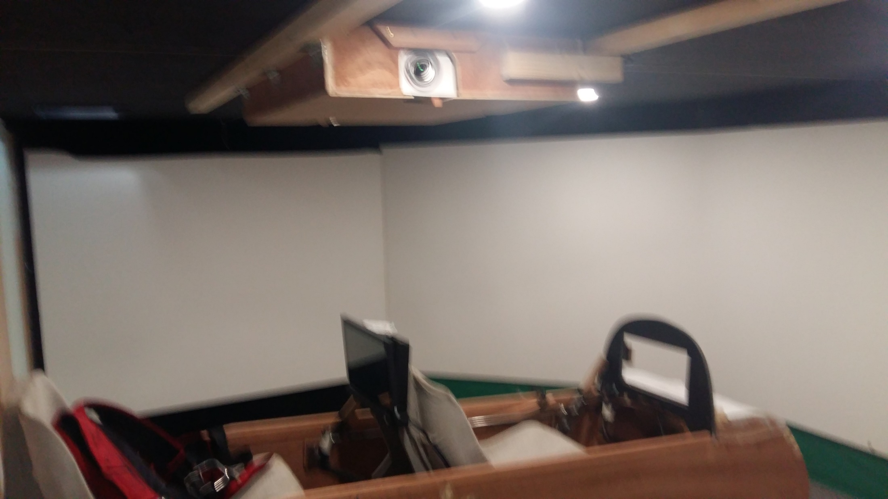
Essex Gliding Club

Slide 11
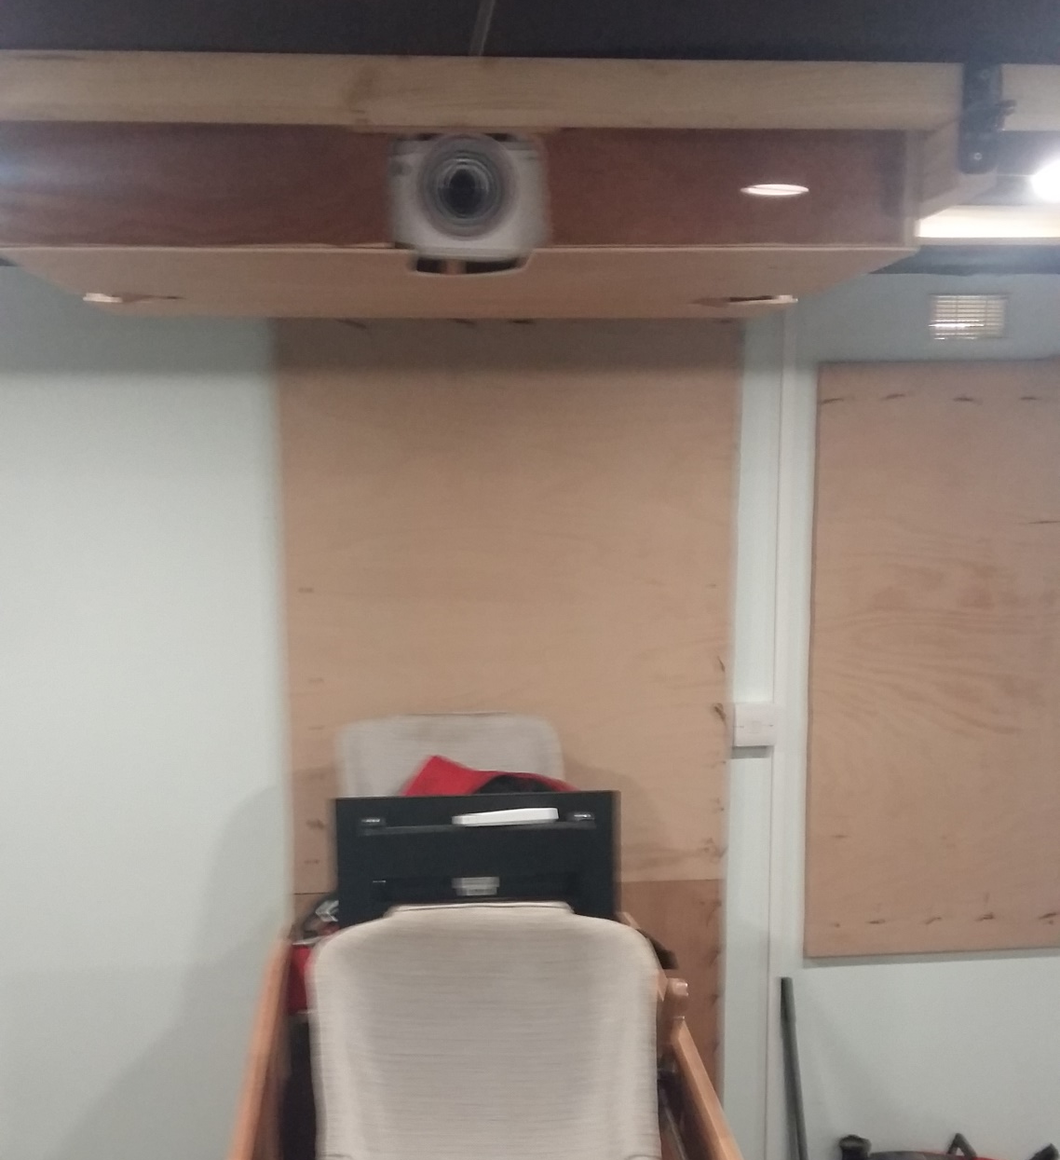
Essex Gliding Club

Slide 12
Unique (?) aspects:
Essex Gliding Club
Use of ‘MagnetoPots’ in place of normal ‘Rotary’ pots
Separate computer controlling the ‘Touch Screens’
Use of ‘Teensy’ microcontroller to pass messages between touch screen computer and Condor computer
Automatic logging of member’s usage for charging purposes
Seat vibration for added realism

Slide 13
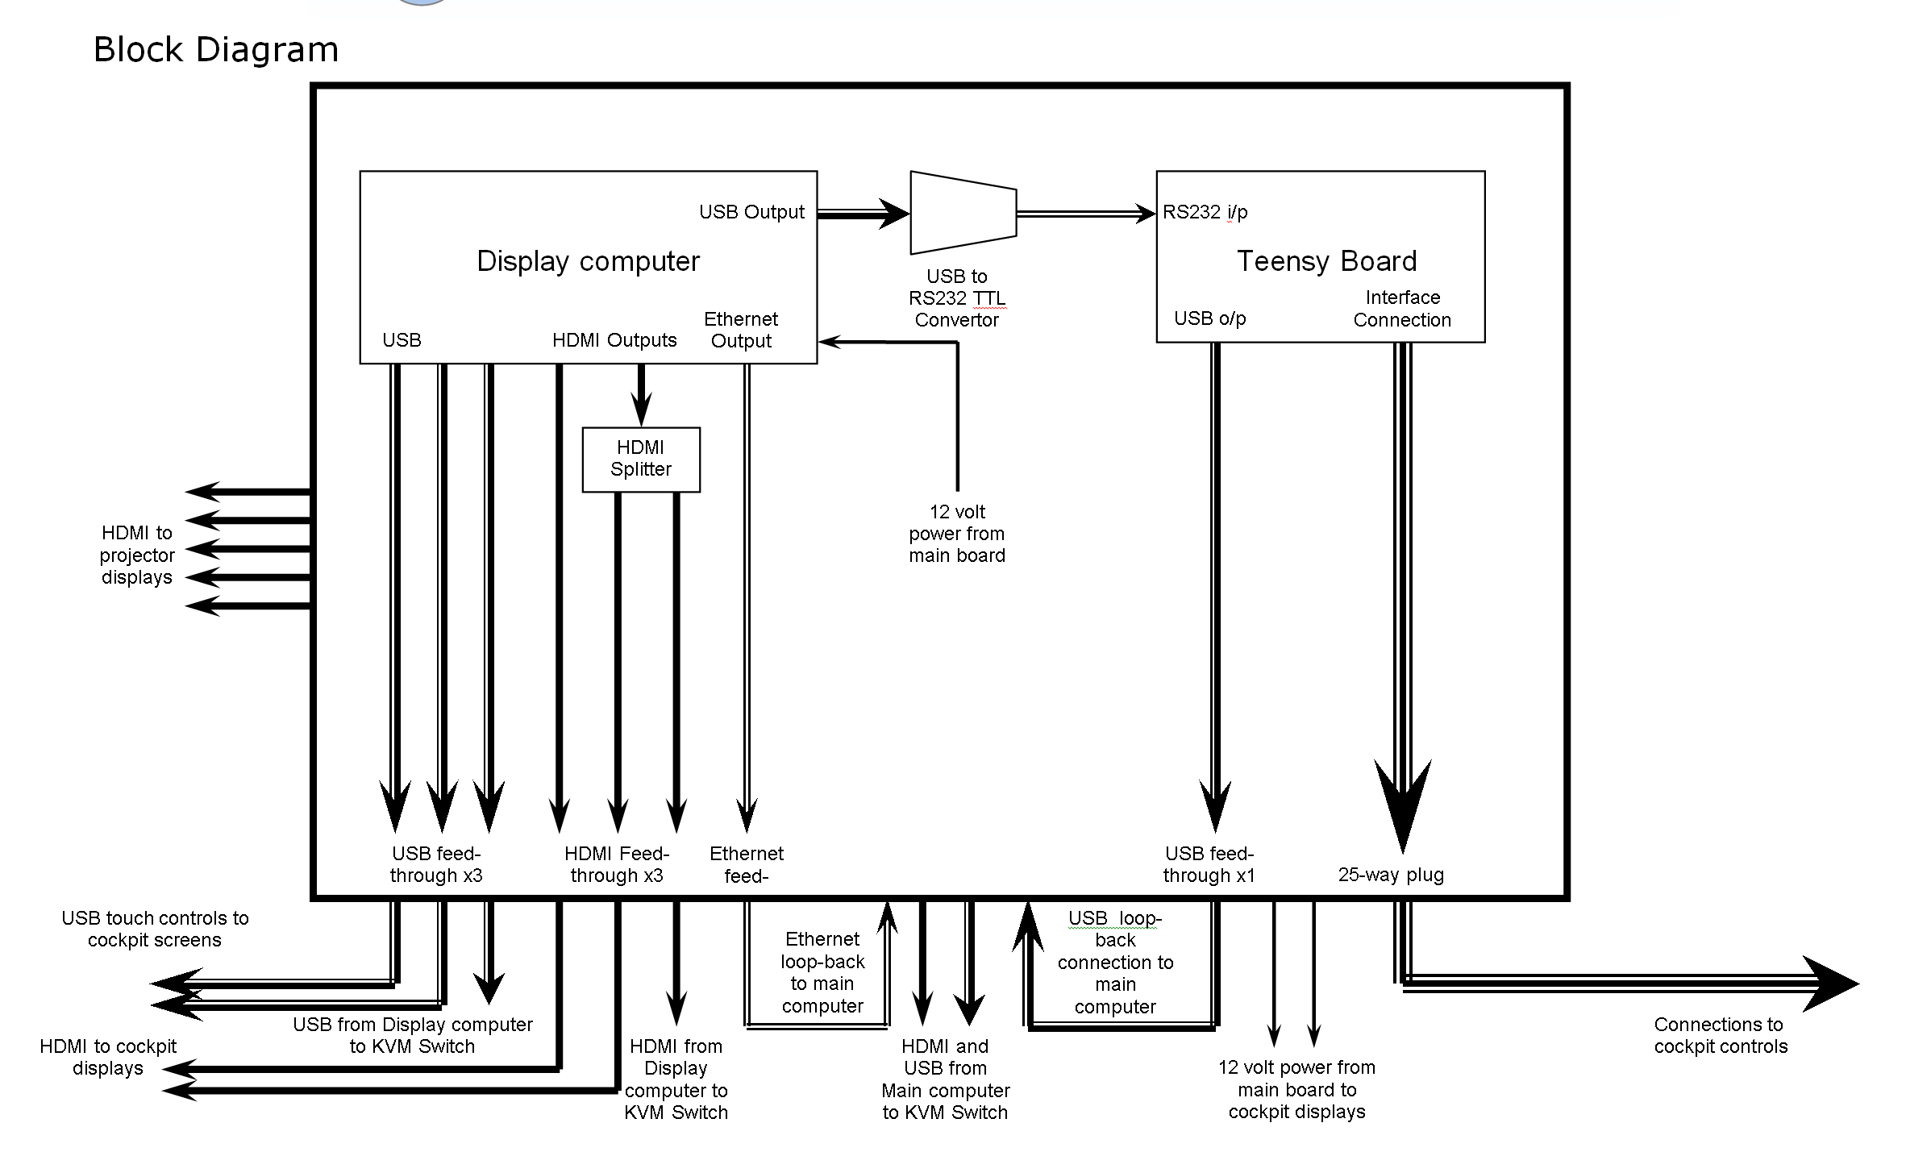
Essex Gliding Club

Slide 14
Essex Gliding Club

Slide 15
Essex Gliding Club

Slide 16
Essex Gliding Club

Slide 17
Essex Gliding Club

Slide 18
Essex Gliding Club

Slide 19
Essex Gliding Club

Slide 20
Essex Gliding Club

Slide 21
Essex Gliding Club

Slide 22
Essex Gliding Club

Slide 23
Essex Gliding Club

Slide 24
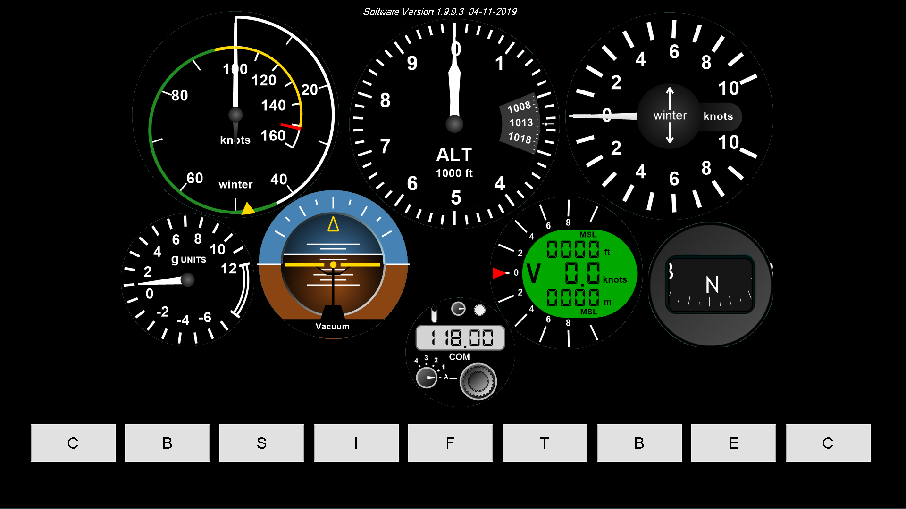
Essex Gliding Club

Slide 25
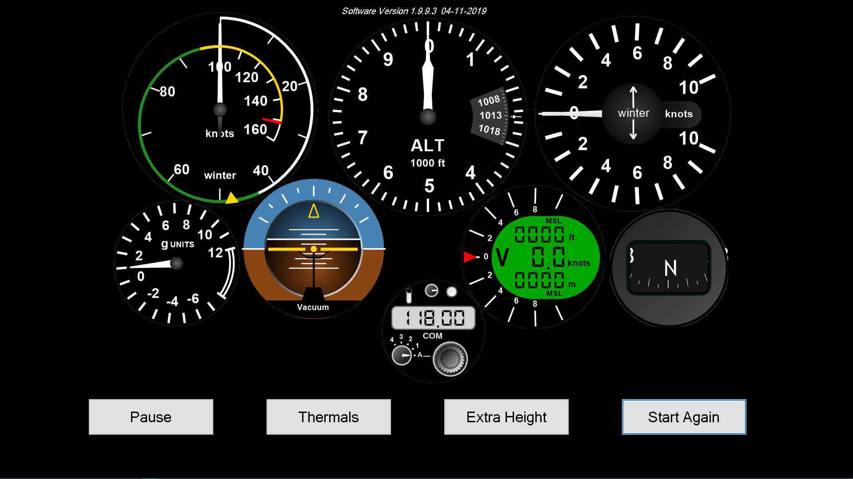
Essex Gliding Club

Slide 26
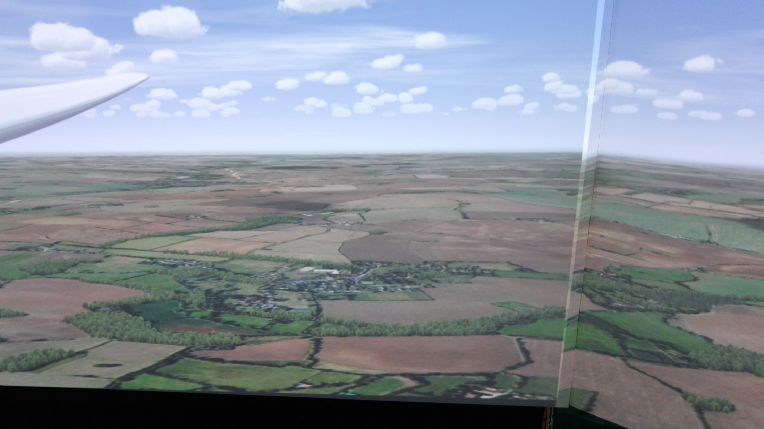
Essex Gliding Club

Slide 27
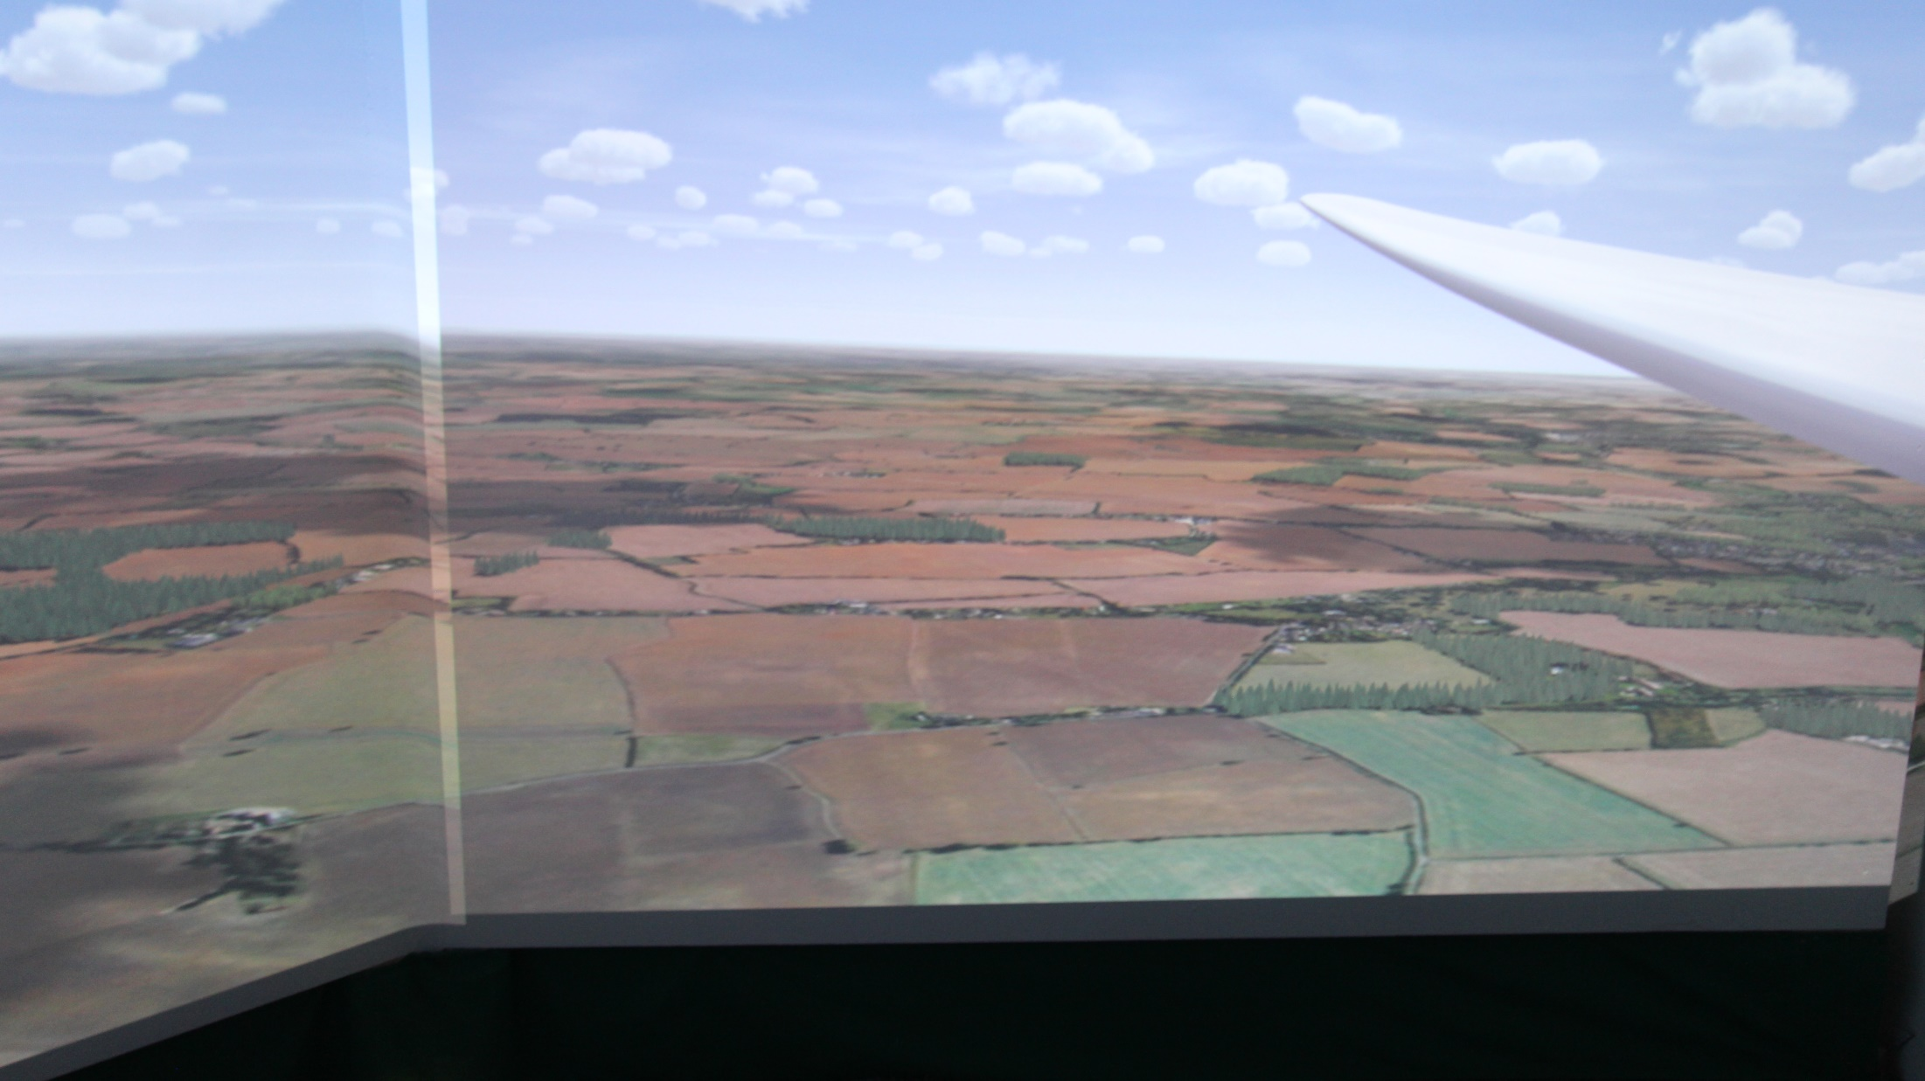
Essex Gliding Club

Slide 28
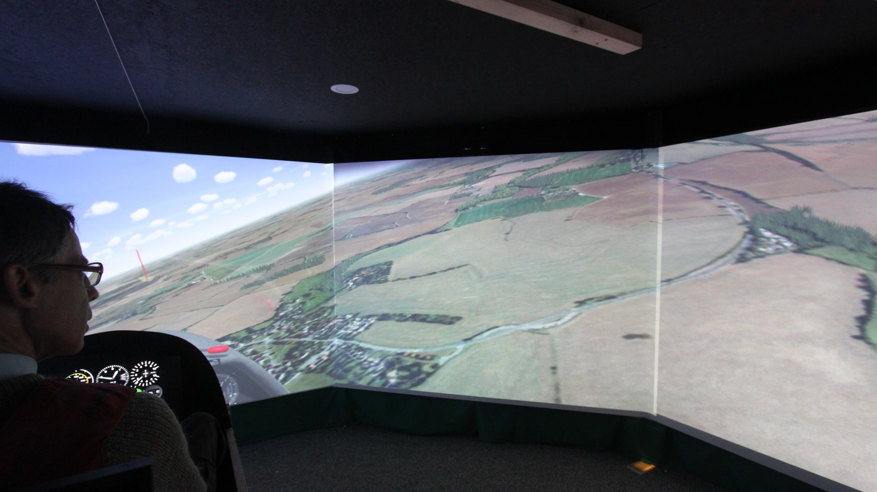
Essex Gliding Club

